Slide 1


Project
FINAL CAPSTONE PRESENTATION

Slide 2

índice
1
6
11
Project Members
Limitations
Cash Flow
2
7
12
Problem Statement
Applied Methodologies
Program Presentation
3
8
13
Solution
Schedule / Timeline
Future Improvements
4
9
14
Objectives
Technologies and Tools
Questions
5
10
Project Scope
Database Model

Slide 3

PROJECT MANAGER
EDISON PARDO
Project Members
SCRUM MASTER
RENATO CHICAHUAL
DEVELOPER
ALEXIS GONZÁLEZ
QA
DIEGO ACEVEDO

Slide 4

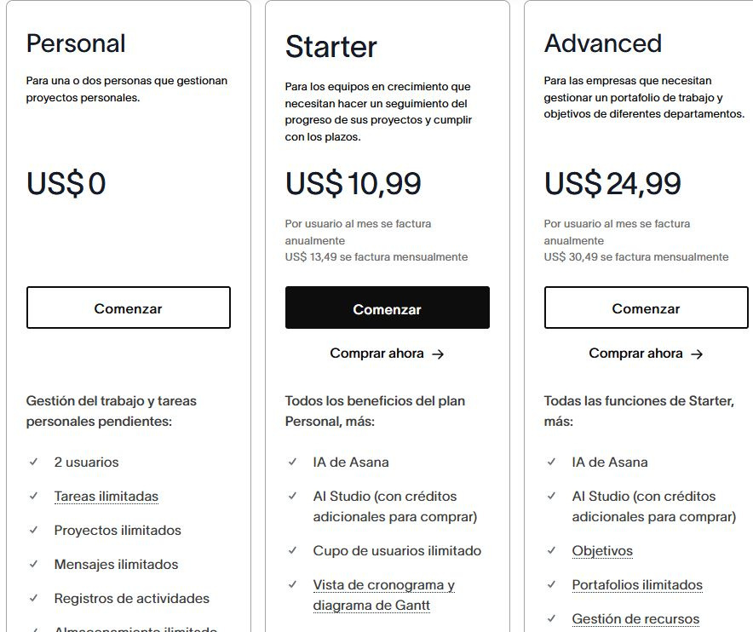
Problem Statement
Currently, many SMEs (Small and Medium-sized Enterprises), startups, students, and educational teams face difficulties managing projects efficiently due to:
  Costly Tools: Platforms like Jira, Notion, or others have premium plans that are inaccessible for small budgets.
  Complexity: Overloaded interfaces that require prolonged training.
  Lack of Automation: Repetitive tasks (documentation, descriptions) consume valuable time.

Slide 5

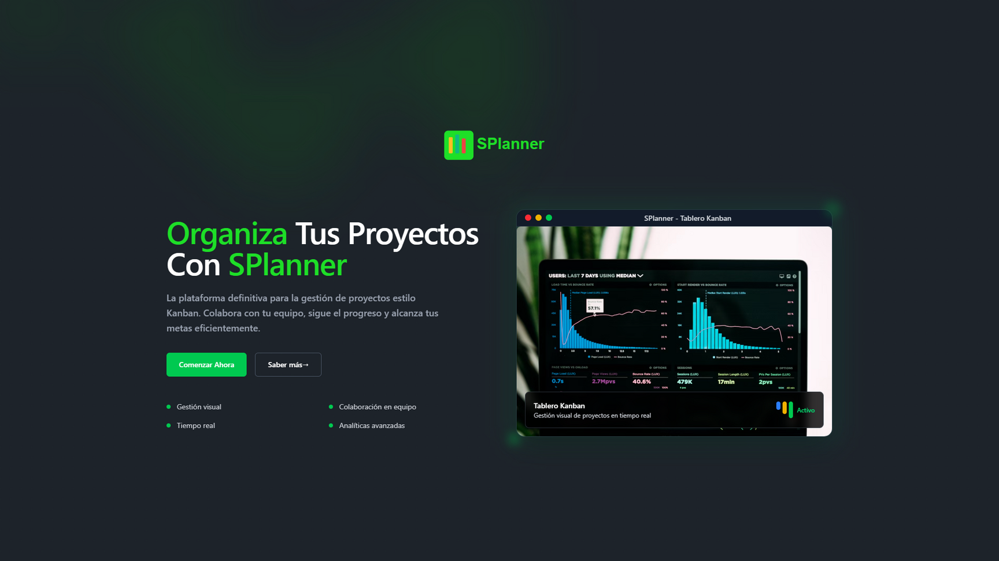
Solution
Our purpose is to design and develop an intelligent Kanban manager with AI integration that is accessible, automated, and adapted to the Latin American market.
It is justified because:
  It addresses the lack of accessible and usable tools for small organizations.
  It offers a simple interface in Spanish, reducing the barrier to entry.
  It includes AI to automate tasks such as project documentation.
Thynk Unlimited

Slide 6




OBJECTIVES
01. Accessibility
03. Scalability
To offer an accessible platform with an intuitive interface to reduce (or simplify) large amounts of information.
To deliver a functional MVP (Minimum Viable Product) that can evolve in the future with more functionalities and integrations.
02. Organization
04. Automation
To facilitate the management of tasks, roles, permissions, and workflows using an intuitive Kanban board.
To use AI to automate repetitive tasks such as document generation, progress tracking, or information summarization.

Slide 7
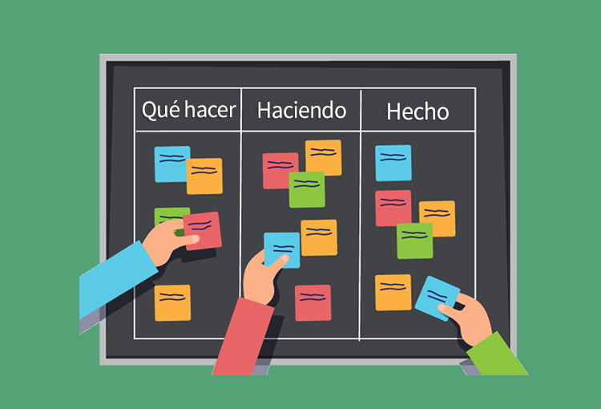


Project Scope
The project covers:
  Kanban Board with basic functionalities.
  Differentiated user roles and permissions.
  Data export and personalized templates (or custom templates).
  User interaction.
  AI implementation.
  Real-time data visualization (Dashboard).
Estimated duration: 5 months

Slide 8
Limitations
01. Extremely Tight Schedule
  Very tight time frame for some members.
04. Team Coordination
  4 different roles (Dev, PO, Scrum Master, QA).
  Constant communication required.
02. Limited Resources
  Free APIs with restrictions.
05. Reduced Scope
  Does not include: external integrations, BI (Business Intelligence), push notifications.
03. Technical Complexity
  Simultaneous AI + Kanban integration.
  Learning curve for Angular, PrismaDB, and Docker.
06. Limited Validation
  Little time for feedback from real users.

Slide 9
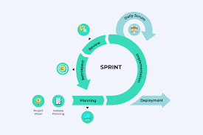
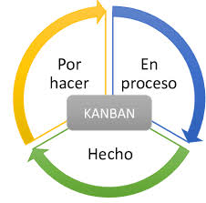

Applied Methodologies
SCRUM
KANBAN
25010 AND 27001

Slide 10

Schedule / Timeline

Slide 11
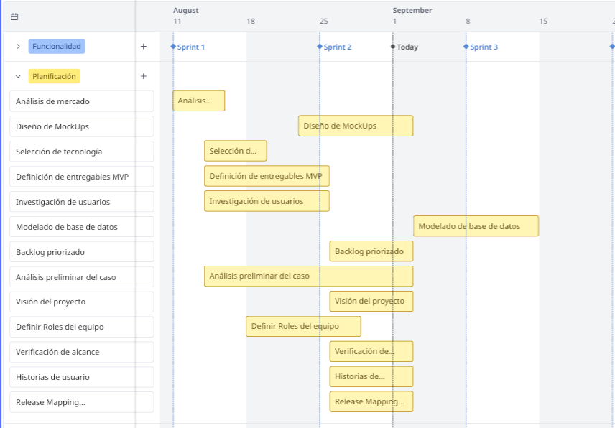

Slide 12
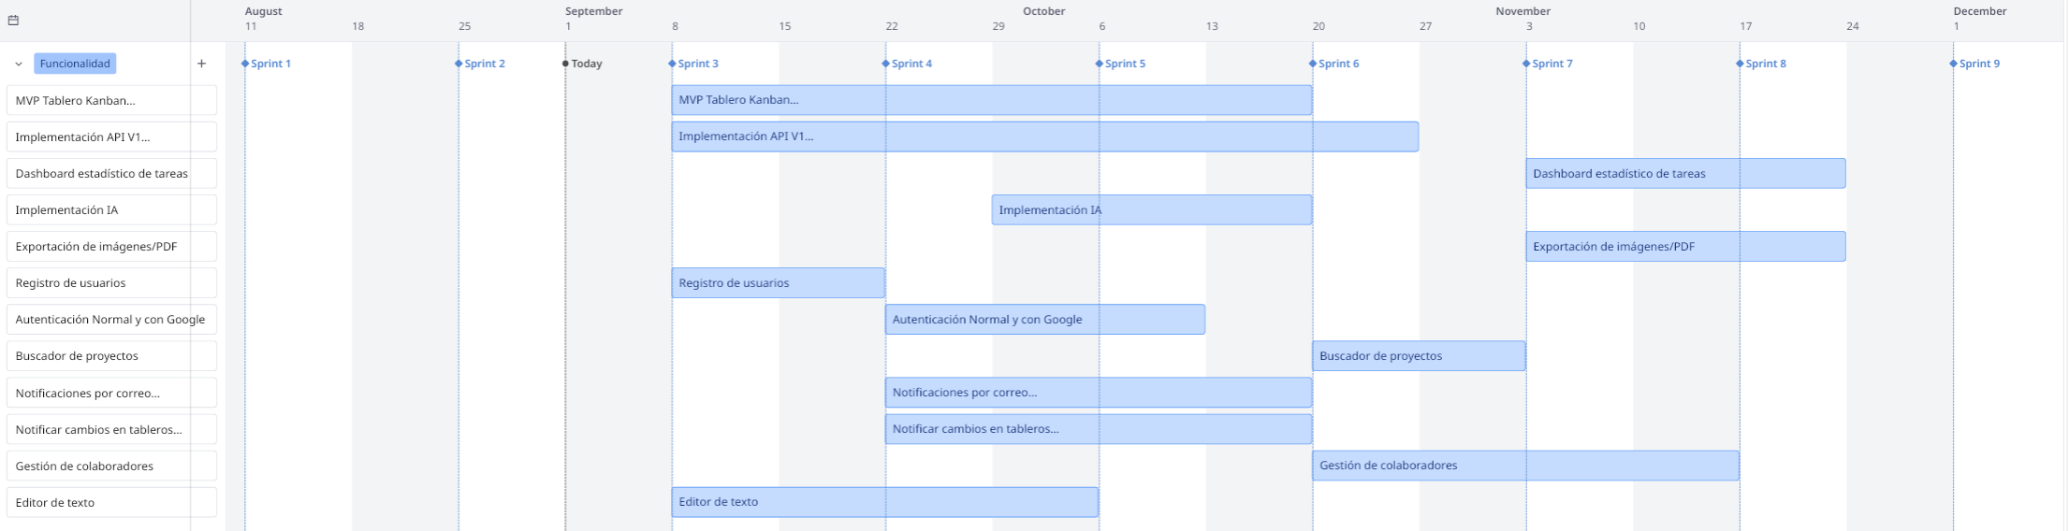

Slide 13
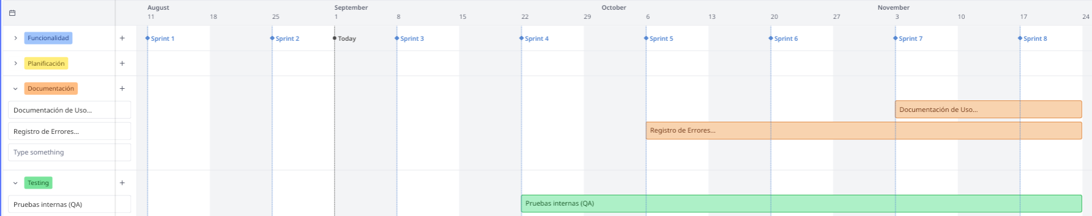

Slide 14
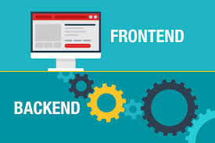


Technologies and Tools
BackEnd/FrontEnd
Suppport
01
02
03
Planification
  Angular.
  GitHub y Git
  User Story Map
  Figma
  Roadmap
  PrismaDB
  Excel
  Notion
  Miro
  ExpressJS.
  Visual Studio Code
  PostgreSQL.
  Data Modeler
  Tailwindcss
  Docker

Slide 15
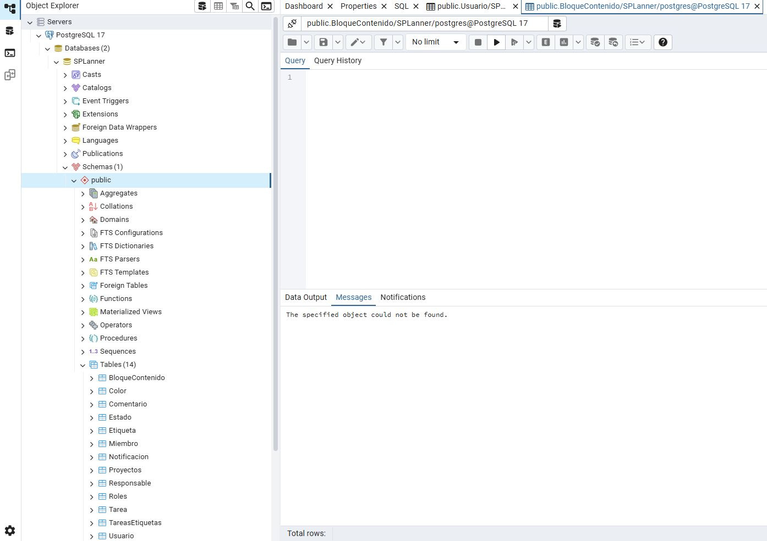

Relational database
PostgreSQL

Slide 16
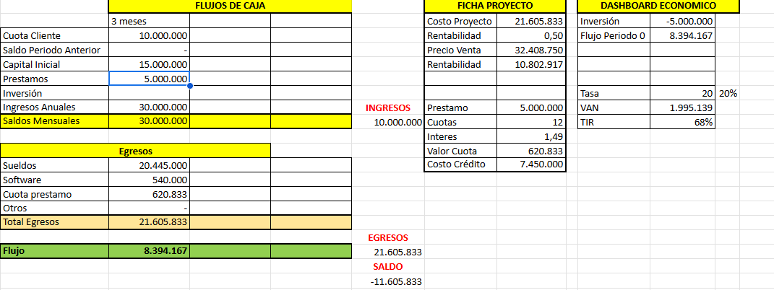
Cash flow

Slide 17
Capstone
Program presentation

Slide 18
Capstone
Future improvements

Slide 19
Capstone
Thank you!!

